Slide 1
Java Programming
Java Programming IT-11

Slide 2
About Java
Java is a high level, robust, object-oriented and secure programming language.
Java was developed by Sun Microsystems (which is now the subsidiary of Oracle) in the year 1995.
James Gosling is known as the father of Java.

Slide 3
Types of Java Applications :
Standalone Application :
Standalone applications are also known as desktop applications or window-based applications. These are traditional software that we need to install on every machine. Examples of standalone application are Media player, antivirus, etc.

Slide 4
Types of Java Applications :
Web Application :
An application that runs on the server side and creates a dynamic page is called a web application. Currently, Servlet, JSP, Struts, Spring, Hibernate, JSF, etc. technologies are used for creating web applications in Java.

Slide 5
Types of Java Applications :
Enterprise Application :
An application that is distributed in nature, such as banking applications, etc. is called an enterprise application. It has advantages like high-level security, load balancing, and clustering. In Java, EJB is used for creating enterprise applications.

Slide 6
Types of Java Applications :
Mobile Application :
An application which is created for mobile devices is called a mobile application. Currently, Android and Java ME are used for creating mobile applications.

Slide 7
Flavours in Java Flavours in Java Flavours in Java Flavors in Java :
All categories of Java has been divided into 3 division and by learning each version of java, we can develop various kind of applications.
Java has been categorized into three flavors.

Slide 8
Flavors in Java :
Java Standard Edition :
It is known as JSE
It is a very basic version and is the first flavor of Java Language.
When we starting to learn Java, first we should learn Java Standard Edition(JSE) as this particular version of Java includes the basic application structure, Fundamental structure (Operator. Data type, OOP concept), Exception Handling and File handling.

Slide 9
Flavors in Java :
Java Standard Edition :
It is also known as core Java. Standard edition is a widely used platform for computer programming in the Java language.
Java SE consists of the virtual machine which must be used to run Java programs

Slide 10
Flavors in Java :
Java Enterprise Edition:
It is known as J2EE or JEE.
J2EE is build up from JSE with additional features for business purpose.
It has extra libraries which can be used to develop JEE applications.
This software is based largely on modular component running on an application server.
To develop the application such as Desktop base and web base we can use J2EE.

Slide 11
Flavors in Java :
Java Micro Edition :
It is known as J2ME or JME
Java ME is a Java platform used to design for embedded systems(Mobile devices are one kind of such systems, Mobile phones, PDAs).
Nowadays, this version is very popular for mobile application development – Android is the best example for use of Java ME

Slide 12
Java Program Development Environment
Java applications are typically compiled to bytecode that can run on any Java virtual machine (JVM) regardless of computer architecture.
Java Development Environment includes :
JVM, JRE, and JDK

Slide 13
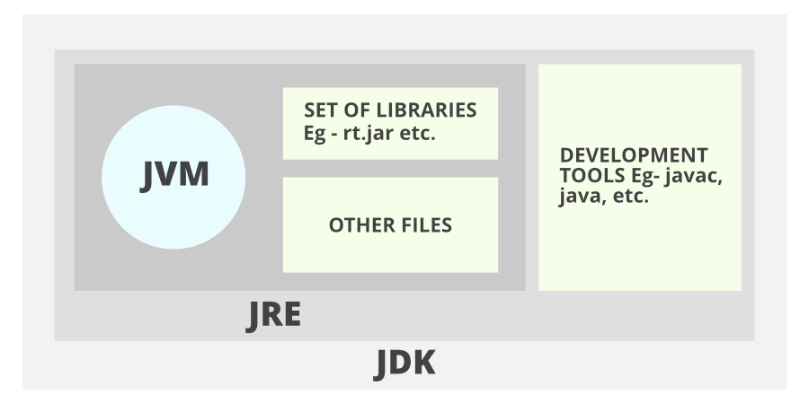
Java Program Development Environment

Slide 14
Java Program Development Environment
JDK(Java Development Kit): JDK is intended for software developers and includes development tools such as the Java compiler, Javadoc, Jar, and a debugger.
JRE(Java Runtime Environment): JRE contains the parts of the Java libraries required to run Java programs and is intended for end-users. JRE can be viewed as a subset of JDK.
JVM: JVM (Java Virtual Machine) is an abstract machine. It is a specification that provides a runtime environment in which java bytecode can be executed. JVMs are available for many hardware and software platforms.

Slide 15
Characteristics of Java
Object oriented:
Java provides the basic object technology of C++ with some enhancements and some deletions.
Architecture neutral:
Java source code is compiled into architecture-independent object code. The object code is interpreted by a Java Virtual Machine (JVM) on the target architecture.

Slide 16
Characteristics of Java
Portable :
Java is portable, because of bytecode.
Distributed:
Java contains extensive TCP/IP networking facilities. Library routines support protocols such as HyperText Transfer Protocol (HTTP) and file transfer protocol (FTP).

Slide 17
Characteristics of Java
Robust :
Both the Java compiler and the Java interpreter provide extensive error checking. Java manages all dynamic memory, checks array bounds, and other exceptions.
Secure :
Features of C and C++ that often result in illegal memory accesses are not in the Java language.
The interpreter also applies several tests to the compiled code to check for illegal code.

Slide 18
Characteristics of Java
High performance :
Compilation of programs to an architecture independent machine-like language, results in a small efficient interpreter of Java programs.
The Java environment also compiles the Java bytecode into native machine code at runtime.
Multithreaded :
Multithreading is built into the Java language.

Slide 19
Characteristics of Java
Dynamic :
Java does not link invoked modules until runtime.
Simple :
Java is similar to C++, but with most of the more complex features of C and C++ removed.

Slide 20
Characteristics of Java
Java does not provide:
Programmer-controlled dynamic memory
Pointer arithmetic
struct
typedefs
#define

Slide 21
Sample java Program :
class FirstProgram
{
public static void main(String []args)
{
System.out.println("Hello world");
}
}
Save this Program : FirstProgram.java
Compile this Program : javac FirstProgram.java
Run this Program : java FirstProgram

Slide 22
Sample java Program 2:
class SecondProgram
{
int showAmout(int principal,int interest)
{
int result=principal*interest/100;
return result;
}
}

Slide 23
Sample java Program 2:
class SecondResult
{
public static void main(String args[])
{
SecondProgram p=new SecondProgram();
int R=p.showAmout(1000,10);
System.out.println("The total interest amount is: " +R);
}
}

Slide 24
Data types in Java :
Every individual bit of data that is processed every day is categorized into types. The type of data is known as data type. Java uses various kinds of data types.
Primitive Data Types-These data types are already hard coded into the compiler to be recognized when the program is executed. Examples are- int , float etc.
Non-Primitive Data Types- These data types are special types of data which are user defined. Some examples are- classes, interfaces etc.

Slide 25
Data types in Java :
Primitive Data Types in Java:
Java primitive data types are the ones which are predefined by the programming language.
Without primitive data types it would be impossible to frame programs.
There are 8 types of Java primitive data types namely:
a. Int b. Float c. Char d. Boolean e. Byte f. Short g. long h. Double.

Slide 26
Data types in Java :
Character : char as the name suggests is useful for storing single value characters. Its default value is ‘\u0000’ with the max value being ‘\uffff’ and has a size of 2 bytes.
Example- char a=’D’;
Boolean : boolean is a special datatype which can have only two values ‘true’ and ‘false’. It has a default value of ‘false’ and a size of 1 byte. It comes in use for storing flag values.
Example- boolean flag=true;

Slide 27
Data types in Java :
Byte : It’s an 8 bit signed two’s complement . The range of values are -128 to 127. It is space efficient because it is smaller than integer datatype.
Example- byte a = 10;
Short : This datatype is also similar to the integer datatype. However it’s 2 times smaller than the integer datatype. Its minimum range is -32,768 and maximum range is 32,767. It has a size of
Example- short a= 54;

Slide 28
Data types in Java :
Integer : int is used for storing integer values. Its size is 4 bytes and has a default value of 0. The maximum values of integer is 2^31 and the minimum value is -2^31.
Example- int a=56;
Long : This datatype primarily stores huge sized numeric data. It is a 64 bit integer and ranges from -2^63 to +(2^63)-1. It has a size of 8 bytes and is useful when you need to store data which is longer than int datatype.
Example- long a= 1273762;

Slide 29
Data types in Java :
Float : float is used for storing decimal values. Its default value is 0.0f and has a size of 4 bytes.
Example- float a=98.7f;
Double :This is similar to the float datatype. It has a range of -2^31 to (2^31)-1.
Example- double DataFlair=99.987d;

Slide 30
Data types in Java :
Non-primitive Data Types in Java:
These are the datatypes which have instances like objects. Hence they are called reference variables. They are primarily classes, arrays, strings or interfaces.
Strings : string is a collection of characters but in Java String is a completely different class altogether. It’s located in java.lang.String.
Example: String s=”Learning java is fun”;

Slide 31
Data types in Java :
Arrays : Arrays are special memory locations that can store a collection of homogeneous data. They are indexed. Arrays always start indexing from 0. Dynamic allocation of arrays is there in Java. Arrays in Java can be passed as method parameters, local variables and static fields.
Example- int arr[] = new int[100];

Slide 32
Java Control Statements :
Java compiler executes the code from top to bottom. The statements in the code are executed according to the order in which they appear. However, Java provides statements that can be used to control the flow of Java code. Such statements are called control flow statements. It is one of the fundamental features of Java, which provides a smooth flow of program.

Slide 33
Java Control Statements
Java provides three types of control flow statements.
Decision Making statements
if statements
switch statement
Loop statements
do while loop
while loop
for loop
for-each loop

Slide 34
Java Control Statements
Jump statements
break statement
continue statement

Slide 35
Java Control Statements
Decision-Making statements:
As the name suggests, decision-making statements decide which statement to execute and when. Decision-making statements evaluate the Boolean expression and control the program flow depending upon the result of the condition provided. There are two types of decision-making statements in Java, i.e., If statement and switch statement.

Slide 36
Java Control Statements
If Statement: In Java, the "if" statement is used to evaluate a condition. The control of the program is diverted depending upon the specific condition. The condition of the If statement gives a Boolean value, either true or false. In Java, there are four types of if-statements given below.
Simple if statement
if-else statement
if-else-if ladder
Nested if-statement

Slide 37
Java Control Statements
Simple if statement:
It is the most basic statement among all control flow statements in Java. It evaluates a Boolean expression and enables the program to enter a block of code if the expression evaluates to true.
Syntax of if statement is given below.
if(condition)
{
statement 1; //executes when condition is true
}

Slide 38
Java Control Statements
Example:
public class Student {
public static void main(String[] args) {
int x = 10;
int y = 12;
if (x + y > 20) {
System.out.println("x + y is greater than 20");
}
}
}
Output: x + y is greater than 20

Slide 39
Java Control Statements
if-else statement :
The if-else statement is an extension to the if-statement, which uses another block of code, i.e., else block. The else block is executed if the condition of the if-block is evaluated as false.
Syntax:
if (condition) {
statement 1; //executes when condition is true
} else {
statement 2; //executes when condition is false
}

Slide 40
Java Control Statements
public class Student {
public static void main(String[] args) {
int x = 10;
int y = 12;
if (x + y < 10) {
System.out.println("x + y is less than 10");
} else {
System.out.println("x + y is greater than 20");
}
}
}

Slide 41
Java Control Statements
if-else-if ladder: The if-else-if statement contains the if-statement followed by multiple else-if statements. In other words, we can say that it is the chain of if-else statements that create a decision tree where the program may enter in the block of code where the condition is true. We can also define an else statement at the end of the chain.
Syntax of if-else-if statement is given below.

Slide 42
Java Control Statements
if (condition 1)
{
statement 1; //executes when condition 1 is true
}
else if (condition 2)
{
statement 2; //executes when condition 2 is true
}
else
{
statement 2; //executes when all the conditions are false
}

Slide 43
Java Control Statements
public class Student {
public static void main(String[] args) {
String city = "Delhi";
if (city == "Meerut") {
System.out.println("city is meerut");
} else if (city == "Noida") {
System.out.println("city is noida");
} else if (city == "Agra") {
System.out.println("city is agra");
} else {
System.out.println(city);
}
}
}

Slide 44
Java Control Statements
Nested if-statement: In nested if-statements, the if statement can contain a if or if-else statement inside another if or else-if statement.
Syntax
if (condition 1)
{
statement 1; //executes when condition 1 is true
if (condition 2)
{
statement 2; //executes when condition 2 is true
}
else
{
statement 2; //executes when condition 2 is false
}
}

Slide 45
Java Control Statements
public class Student {
public static void main(String[] args) {
String address = "Delhi, India";
if (address.endsWith("India")) {
if (address.contains("Meerut")) {
System.out.println("Your city is Meerut");
} else if (address.contains("Noida")) {
System.out.println("Your city is Noida");
} else {
System.out.println(address.split(",")[0]);
}
} else {
System.out.println("You are not living in India");
}
}
}

Slide 46
Java Control Statements
Switch Statement: In Java, Switch statements are similar to if-else-if statements. The switch statement contains multiple blocks of code called cases and a single case is executed based on the variable which is being switched. The switch statement is easier to use instead of if-else-if statements. It also enhances the readability of the program.

Slide 47
Java Control Statements
The case variables can be int, short, byte, char, or enumeration. String type is also supported since version 7 of Java
Cases cannot be duplicate
Default statement is executed when any of the case doesn't match the value of expression. It is optional.
Break statement terminates the switch block when the condition is satisfied. It is optional, if not used, next case is executed.

Slide 48
Java Control Statements
switch (expression) {
case value1:
statement1;
break;
.
.
.
case valueN:
statementN;
break;
default:
default statement;
}

Slide 49
Java Control Statements
public class Student {
public static void main(String[] args) {
int num = 2;
switch (num) {
case 0:
System.out.println("number is 0");
break;
case 1:
System.out.println("number is 1");
break;
default:
System.out.println(num);
}
}
}

Slide 50
Java Control Statements
Loop Statements : In programming, sometimes we need to execute the block of code repeatedly while some condition evaluates to true. However, loop statements are used to execute the set of instructions in a repeated order. The execution of the set of instructions depends upon a particular condition.

Slide 51
Java Control Statements
In Java, we have three types of loops that execute similarly. However, there are differences in their syntax and condition checking time.
for loop
while loop
do-while loop

Slide 52
Java Control Statements
while loop :
The while loop is used to iterate over the number of statements multiple times. However, if we don't know the number of iterations in advance, it is recommended to use a while loop.
It is also known as the entry-controlled loop since the condition is checked at the start of the loop. If the condition is true, then the loop body will be executed; otherwise, the statements after the loop will be executed.

Slide 53
Java Control Statements
syntax :
while (condition) {
//looping statements
}
Example :
public class Calculation {
public static void main(String[] args) {
int i = 0;
System.out.println("Printing the list of first 10 even numbers \n");
while (i <= 10) {
System.out.println(i);
i = i + 2;
}
}
}

Slide 54
Java Control Statements
do-while loop :
The do-while loop checks the condition at the end of the loop after executing the loop statements. When the number of iteration is not known and we have to execute the loop at least once, we can use do-while loop.
It is also known as the exit-controlled loop since the condition is not checked in advance.

Slide 55
Java Control Statements
Syntax:
do {
//statements
}
Example:
public class Calculation {
public static void main(String[] args) {
int i = 0;
System.out.println("Printing the list of first 10 even numbers \n");
do {
System.out.println(i);
i = i + 2;
} while (i <= 10);
}
}

Slide 56
Java Control Statements
for loop : It enables us to initialize the loop variable, check the condition, and increment/decrement in a single line of code. We use the for loop only when we exactly know the number of times, we want to execute the block of code.
Syntax:
for (initialization, condition, increment / decrement) {
//block of statements
}

Slide 57
Java Control Statements
public class Calculation {
public static void main(String[] args) {
int sum = 0;
for (int j = 1; j <= 10; j++)
{
sum = sum + j;
}
System.out.println("The sum of first 10 natural numbers is " + sum);
}
}

Slide 58
Java Control Statements
for-each loop : Java provides an enhanced for loop to traverse the data structures like array or collection. In the for-each loop, we don't need to update the loop variable. The syntax to use the for-each loop in java is given below.
for (data_type var: array_name / collection_name) {
//statements
}

Slide 59
Java Control Statements
public class Calculation {
public static void main(String[] args) {
String[] names = {
"Java",
"C",
"C++",
"Python",
"JavaScript"
};
System.out.println("Printing the content of the array names:\n");
for (String name: names) {
System.out.println(name);
}
}
}

Slide 60
Java Control Statements
Jump Statements :Jump statements are used to transfer the control of the program to the specific statements. In other words, jump statements transfer the execution control to the other part of the program. There are two types of jump statements in Java, i.e., break and continue.

Slide 61
Java Control Statements
break : As the name suggests, the break statement is used to break the current flow of the program and transfer the control to the next statement outside a loop or switch statement. However, it breaks only the inner loop in the case of the nested loop.
The break statement cannot be used independently in the Java program, i.e., it can only be written inside the loop or switch statement.

Slide 62
Java Control Statements
public class BreakExample {
public static void main(String[] args) {
for (int i = 0; i <= 10; i++)
{
System.out.println(i);
if (i == 6)
{
break;
}
}
}
}

Slide 63
Java Control Statements
Continue: Unlike break statement, the continue statement doesn't break the loop, whereas, it skips the specific part of the loop and jumps to the next iteration of the loop immediately.

Slide 64
Java Control Statements
public class ContinueExample {
public static void main(String[] args) {
for (int i = 0; i <= 2; i++) {
for (int j = i; j <= 5; j++) {
if (j == 4) {
continue;
}
System.out.println(j);
}
}
}
}

Slide 65
JAVA BASIC OPERATORS
Java provides a rich set of operators to manipulate variables. We can divide all the Java operators into the following groups:
Arithmetic Operators
Relational Operators
Bitwise Operators
Logical Operators
Assignment Operators
Misc Operators

Slide 66
JAVA BASIC OPERATORS
The Arithmetic Operators:
Arithmetic operators are used in mathematical expressions in the same way that they are used in algebra. The following table lists the arithmetic operators:
Assume integer variable A holds 10 and variable B holds 20 then:

Slide 67
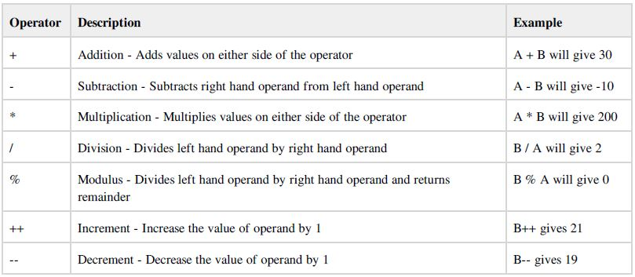
JAVA BASIC OPERATORS

Slide 68
JAVA BASIC OPERATORS
The Relational Operators:
There are following relational operators supported by Java language
Assume variable A holds 10 and variable B holds 20 then:

Slide 69
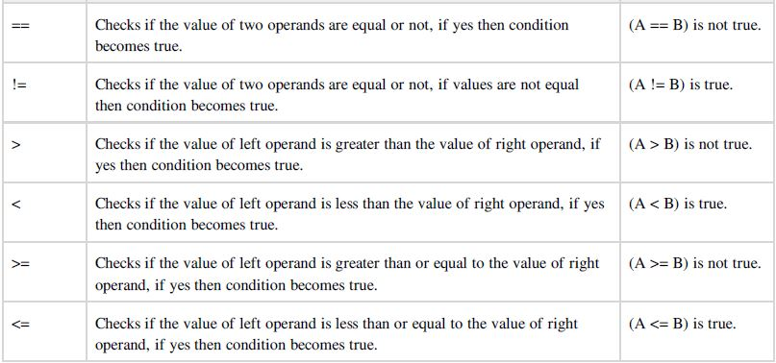
JAVA BASIC OPERATORS

Slide 70
JAVA BASIC OPERATORS
The Bitwise Operators:
Java defines several bitwise operators which can be applied to the integer types, long, int, short, char, and byte.
Bitwise operator works on bits and perform bit by bit operation. Assume if a = 60; and b = 13; Now in binary format
they will be as follows:
a = 0011 1100
b = 0000 1101

Slide 71
JAVA BASIC OPERATORS
a&b = 0000 1100
a|b = 0011 1101
a^b = 0011 0001
~a = 1100 0011
The following table lists the bitwise operators:
Assume integer variable A holds 60 and variable B holds 13 then:

Slide 72
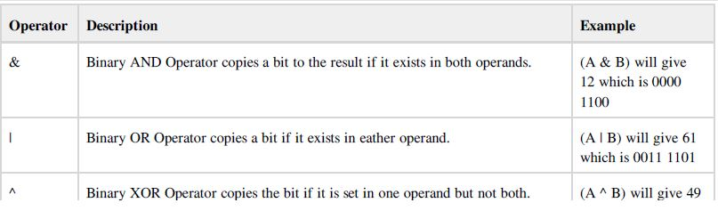
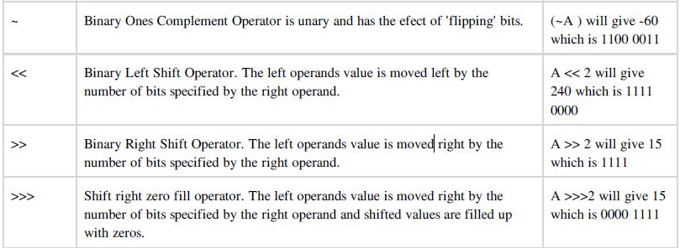
JAVA BASIC OPERATORS

Slide 73
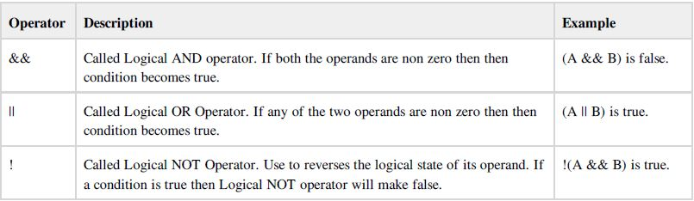
JAVA BASIC OPERATORS
The Logical Operators:
The following table lists the logical operators:
Assume boolean variables A holds true and variable B holds false then:

Slide 74
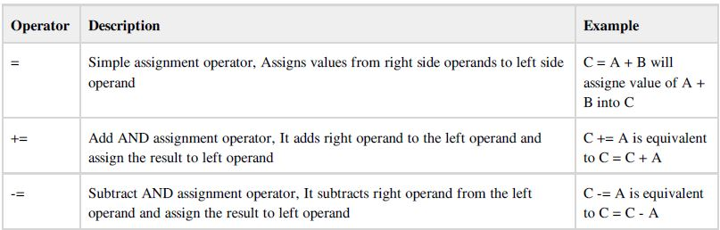
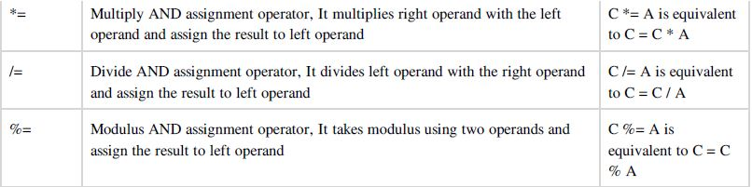
JAVA BASIC OPERATORS
The Assignment Operators:
There are following assignment operators supported by Java language:

Slide 75
Misc Operators
There are few other operators supported by Java Language.
Conditional Operator ( ? : ):
Conditional operator is also known as the ternary operator. This operator consists of three operands and is used to evaluate boolean expressions. The goal of the operator is to decide which value should be assigned to the variable. The operator is written as :

Slide 76
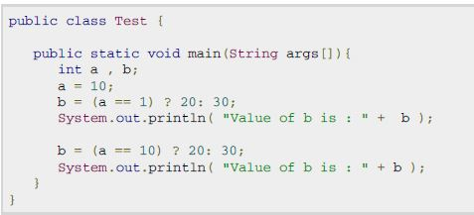
Misc Operators
variable x = (expression) ? value if true : value if false

Slide 77
Misc Operators
instanceOf Operator :
This operator is used only for object reference variables. The operator checks whether the object is of a particular type(class type or interface type). instanceOf operator is wriiten as:
( Object reference variable ) instanceOf (class/interface type)

Slide 78
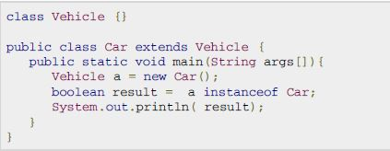
Misc Operators

Slide 79
JAVA - ARRAYS
Java provides a data structure, the array, which stores a fixed-size sequential collection of elements of the same type.
An array is used to store a collection of data, but it is often more useful to think of an array as a collection of variables of the same type.

Slide 80
JAVA - ARRAYS
Declaring Array Variables:
To use an array in a program, you must declare a variable to reference the array, and you must specify the type of array
The variable can reference. Here is the syntax for declaring an array variable:
dataType[] arrayRefVar; // preferred way.
or
dataType arrayRefVar[]; // works but not preferred way.

Slide 81
JAVA - ARRAYS
Creating Arrays:
You can create an array by using the new operator with the following syntax:
arrayRefVar = new dataType[arraySize];
The above statement does two things:
It creates an array using new dataType[arraySize];
It assigns the reference of the newly created array to the variable arrayRefVar.

Slide 82
JAVA - ARRAYS
Declaring an array variable, creating an array, and assigning the reference of the array to the variable can be combined in one statement, as shown below:
dataType[] arrayRefVar = new dataType[arraySize];
Ex : double[] myList = new double[10];

Slide 83
JAVA - ARRAYS
Processing Arrays:
When processing array elements, we often use either for loop or foreach loop because all of the elements in an array are of the same type and the size of the array is known.
Example:

Slide 84
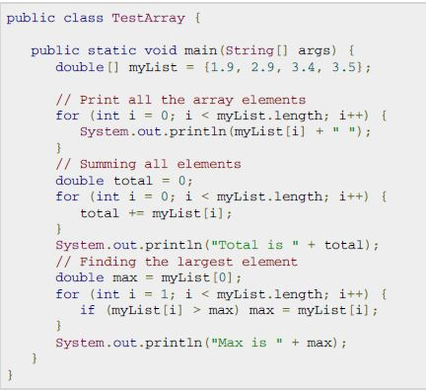
JAVA - ARRAYS

Slide 85
JAVA - ARRAYS
The foreach Loops:
JDK 1.5 introduced a new for loop, known as foreach loop or enhanced for loop, which enables you to traverse the
complete array sequentially without using an index variable.
Example:
The following code displays all the elements in the array myList:

Slide 86
JAVA - ARRAYS
public class TestArray {
public static void main(String[] args) {
double[] myList = {
1.9,
2.9,
3.4,
3.5
};
// Print all the array elements
for (double element: myList) {
System.out.println(element);
}
}
}

Slide 87
JAVA - ARRAYS
Passing Arrays to Methods:
Just as you can pass primitive type values to methods, you can also pass arrays to methods. For example, the following method displays the elements in an int array:
public static void printArray(int[] array) {
for (int i = 0; i < array.length; i++) {
System.out.print(array[i] + " ");
}
}

Slide 88
JAVA - ARRAYS
You can invoke it by passing an array. For example, the following statement invokes the printArray method to display 3, 1, 2, 6, 4, and 2:
printArray(new int[]{3, 1, 2, 6, 4, 2});

Slide 89
Access Modifiers in Java
The access modifiers in Java specifies the accessibility or scope of a field, method, constructor, or class. We can change the access level of fields, constructors, methods, and class by applying the access modifier on it.
There are four types of Java access modifiers:

Slide 90
Access Modifiers in Java
Private: The access level of a private modifier is only within the class. It cannot be accessed from outside the class.
Default: The access level of a default modifier is only within the package. It cannot be accessed from outside the package. If you do not specify any access level, it will be the default.
Protected: The access level of a protected modifier is within the package and outside the package through child class. If you do not make the child class, it cannot be accessed from outside the package.

Slide 91
Access Modifiers in Java
Public: The access level of a public modifier is everywhere. It can be accessed from within the class, outside the class, within the package and outside the package.
Examples:

Slide 92
Access Modifiers in Java
Private :
class A {
private int data = 40;
private void msg() {
System.out.println("Hello java");
}
}
public class Simple {
public static void main(String args[]) {
A obj = new A();
System.out.println(obj.data); //Compile Time Error
obj.msg(); //Compile Time Error
}
}

Slide 93
Access Modifiers in Java
Role of Private Constructor:
If you make any class constructor private, you cannot create the instance of that class from outside the class. For example:
class A {
private A() {} //private constructor
void msg() {
System.out.println("Hello java");
}
}
public class Simple {
public static void main(String args[]) {
A obj = new A(); //Compile Time Error
}
}

Slide 94
Access Modifiers in Java
Default:
If you don't use any modifier, it is treated as default by default. The default modifier is accessible only within package. It cannot be accessed from outside the package. It provides more accessibility than private.
//save by A.java
package pack;
class A {
void msg() {
System.out.println("Hello");
}
}

Slide 95
Access Modifiers in Java
//save by B.java
package mypack;
import pack.*;
class B {
public static void main(String args[]) {
A obj = new A(); //Compile Time Error
obj.msg(); //Compile Time Error
}
}
In the above example, the scope of class A and its method msg() is default so it cannot be accessed from outside the package.

Slide 96
Access Modifiers in Java
Protected :
The protected access modifier is accessible within package and outside the package but through inheritance only.
The protected access modifier can be applied on the data member, method and constructor. It can't be applied on the class.
It provides more accessibility than the default modifer.

Slide 97
Access Modifiers in Java
Example of protected access modifier
In this example, we have created the two packages pack and mypack. The A class of pack package is public, so can be accessed from outside the package. But msg method of this package is declared as protected, so it can be accessed from outside the class only through inheritance.
//save by A.java
package pack;
public class A {
protected void msg() {
System.out.println("Hello");
}
}

Slide 98
Access Modifiers in Java
//save by B.java
package mypack;
import pack.*;
class B extends A {
public static void main(String args[]) {
B obj = new B();
obj.msg();
}
}

Slide 99
Access Modifiers in Java
Public :
The public access modifier is accessible everywhere. It has the widest scope among all other modifiers.
Example of public access modifier
//save by A.java
package pack;
public class A {
public void msg() {
System.out.println("Hello");
}
}

Slide 100
Access Modifiers in Java
//save by B.java
package mypack;
import pack.*;
class B{
public static void main(String args[]){
A obj = new A();
obj.msg();
}
}

